Slide 1














Packet Switching: queueing delay, loss
R = 100 Mb/s
C
A
D
R = 1.5 Mb/s
queue of packets waiting for output link
B
E
queuing and loss:
If arrival rate (in bits) to link exceeds transmission rate of link for a period of time:
packets will queue, wait to be transmitted on link
packets can be dropped (lost) if memory (buffer) fills up

Slide 2




How do loss and delay occur?
packets queue in router buffers
packet arrival rate to link (temporarily) exceeds output link capacity
packets queue, wait for turn
packet being transmitted (delay)
A
B
packets queueing (delay)
free (available) buffers: arriving packets dropped (loss) if no free buffers

Slide 3



Four sources of packet delay
transmission
A
propagation
B
nodal processing
queueing
^{d}nodal ^{= d}proc ^{+ d}queue ^{+ d}trans ^{+ d}prop
d_{proc}: nodal processing
check bit errors
determine output link
typically < msec
d_{queue}: queueing delay
time waiting at output link for transmission
depends on congestion level of router

Slide 4

Four sources of packet delay
transmission
A
propagation
B
nodal processing
queueing
^{d}nodal ^{= d}proc ^{+ d}queue ^{+ d}trans ^{+ d}prop
d_{trans}: transmission delay:
L: packet length (bits)
R: link bandwidth (bps)
d_{trans} =L/R
^{d}trans ^{and d}prop very different
d_{prop}: propagation delay:
d: length of physical link
s: propagation speed in medium
(~2x10⁸ m/sec)
d_{prop} = d/s

Slide 5
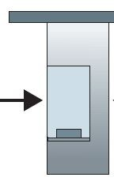



Caravan analogy
100 km
100 km
ten-car caravan
toll booth
toll booth
cars “propagate” at 100 km/hr
toll booth takes 12 sec to service car (bit transmission time)
car~bit; caravan ~ packet
Q:How long until caravan is lined up before 2nd toll booth?
time to “push” entire caravan through toll booth onto highway = 12*10 = 120 sec
time for last car to propagate from 1st to 2nd toll both: 100km/(100km/hr)= 1 hr
A:62 minutes

Slide 6



Caravan analogy (more)
100 km
100 km
ten-car caravan
toll booth
toll booth
suppose cars now “propagate” at 1000 km/hr
and suppose toll booth now takes one min to service a car
Q:Will cars arrive to 2nd booth before all cars serviced at first booth?
A:Yes! after 7 min, 1st car arrives at second booth; three cars still at 1st booth.

Slide 7
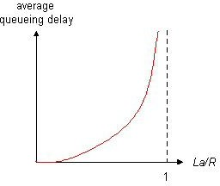

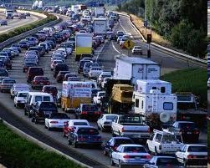
Queueing delay (revisited)
average queueing
delay
R:link bandwidth (bps)
L:packet length (bits)
a: average packet arrival rate
traffic intensity
= La/R
La/R ~ 0: avg. queueing delay small
La/R -> 1: avg. queueing delay large
La/R > 1: more “work” arriving
than can be serviced, average delay infinite!
La/R ~ 0
La/R -> 1

